Slide 2
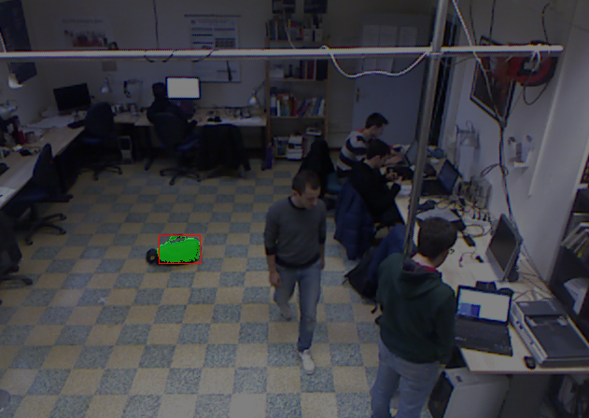
Contents
Contents
Introduction
Approach
Intensity processing
Depth processing
Combination of proposals
Technologies
Development
Test
Performance

Slide 3
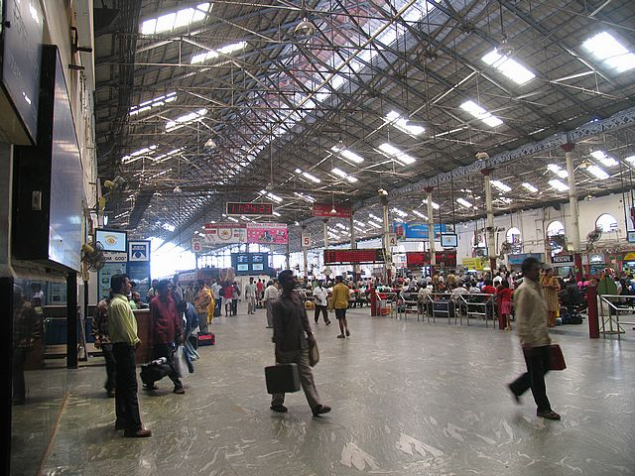
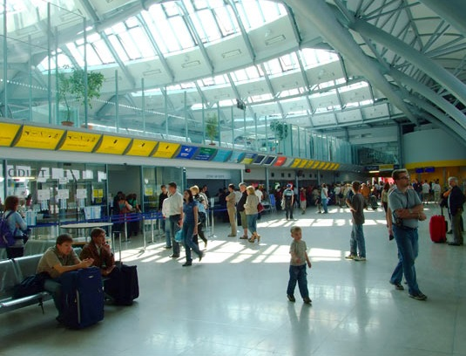
Left luggage detection
Introduction
Detection of abandoned items in public places:
Airports
Train station
Issues:
Shadows
Occlusions
Illumination changes
Clutter

Slide 4
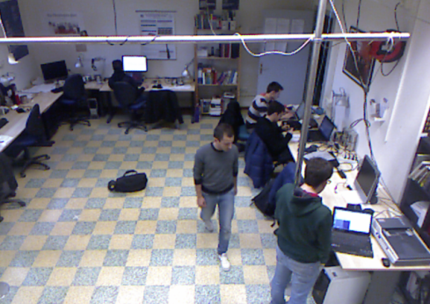
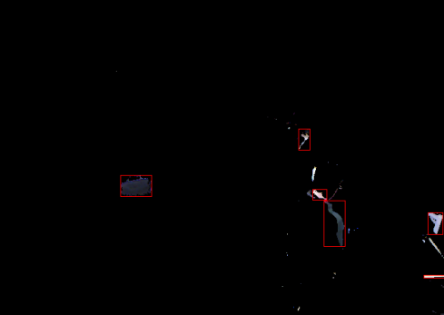

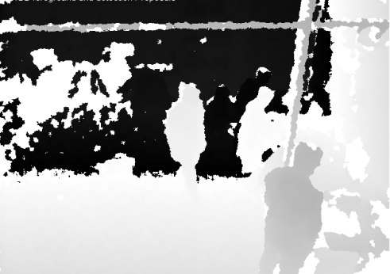
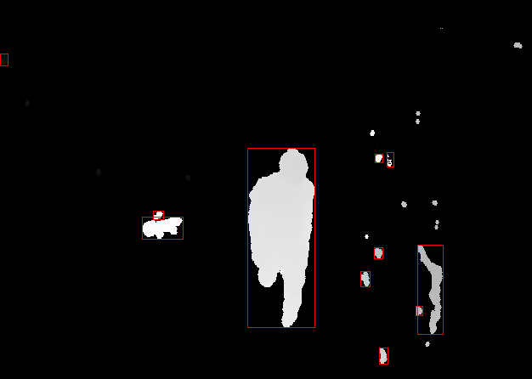
Pipeline
Approach
It is based on Reliable Left Luggage Detection Using Stereo Depth and Intensity Cues – C. Beleznai, P. Gemeiner and C. Zinner^{[1]} of Austrian Institute of Technology
Video stream
Intensity processing
Left luggage proposals
Depth processing

Slide 5
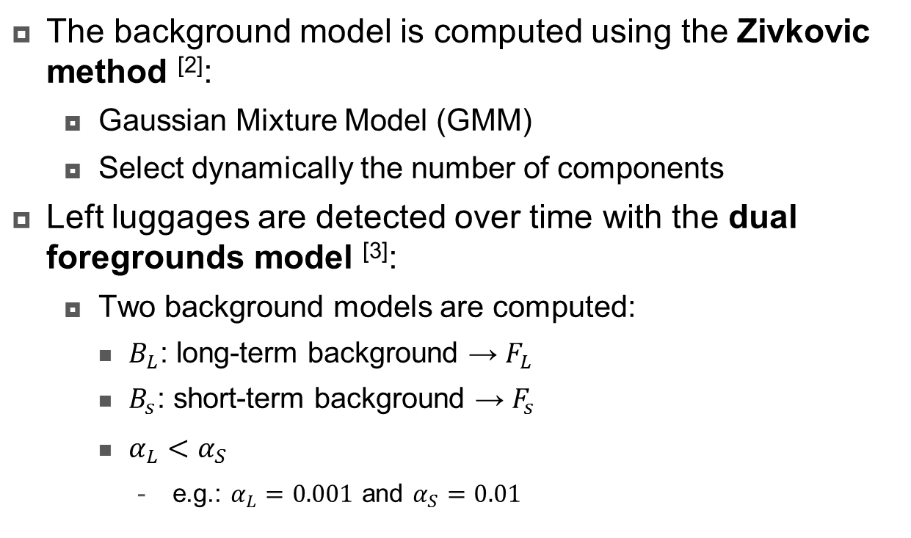
Intensity background modelling
Intensity processing
The background model is computed using the Zivkovic method ^{[2]}:
Gaussian Mixture Model (GMM)
Select dynamically the number of components
Left luggages are detected over time with the dual foregrounds model ^{[3]}:
Two background models are computed:
$B_{L}$: long-term background → $F_{L}$
$B_{s}$: short-term background → $F_{s}$
$α_{L}<α_{S}$
e.g.: $α_{L}=0.001$ and $α_{S}=0.01$

Slide 6
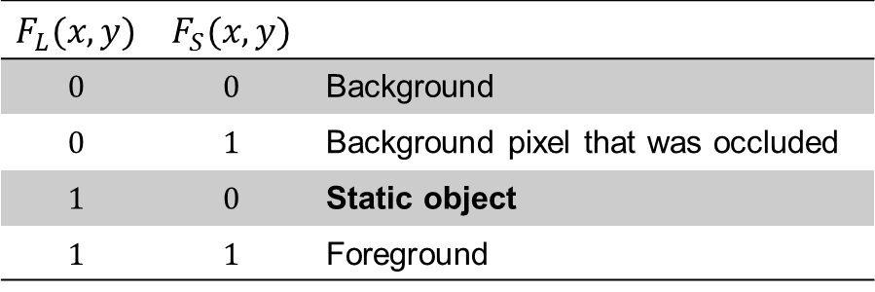

Dual foreground
Intensity processing
Using $F_{L}$ and $F_{s}$ we have four cases for each pixel:
We aggregate the detection into an image $E(x,y)$
It aims to remove noise in the detection;
If $E\left(x,y\right)≥\max_{e}$, the pixel is marked as abandoned item.
$$F_{L}(x,y)$$ | $$F_{S}(x,y)$$
$$0$$ | $$0$$ | Background
$$0$$ | $$1$$ | Background pixel that was occluded
$$1$$ | $$0$$ | Static object
$$1$$ | $$1$$ | Foreground

Slide 7
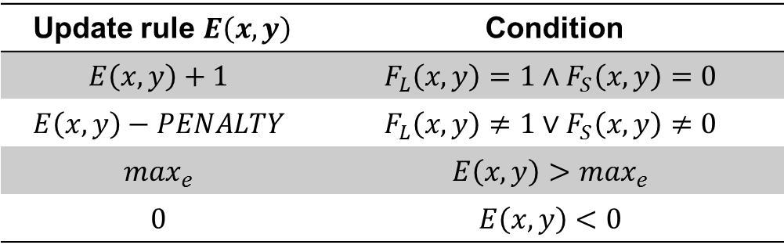
Aggregator update rule
Intensity processing
The aggregator update rule is the following:
A set of bounding box of intensity-based proposals is obtained.
Update rule $E\left(x,y\right)$ | Condition
$$E\left(x,y\right)+1$$ | $$F_{L}\left(x,y\right)=1∧F_{S}\left(x,y\right)=0$$
$$E\left(x,y\right)−PENALTY$$ | $$F_{L}\left(x,y\right)≠1∨F_{S}\left(x,y\right)≠0$$
$$\max_{e}$$ | $$E\left(x,y\right)>\max_{e}$$
$$0$$ | $$E\left(x,y\right)<0$$

Slide 8
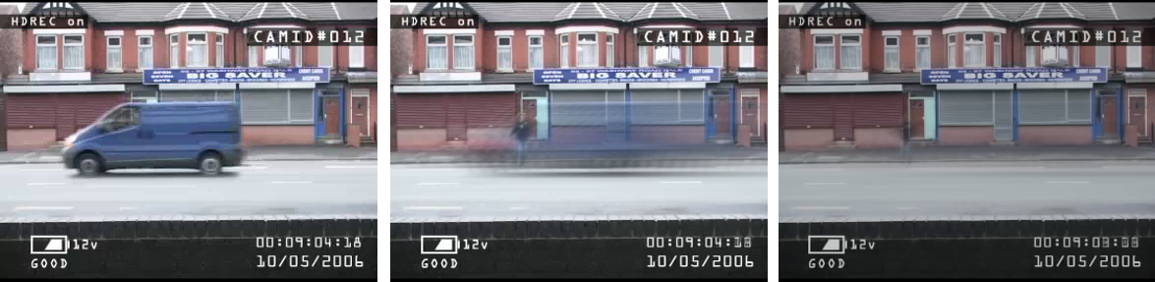
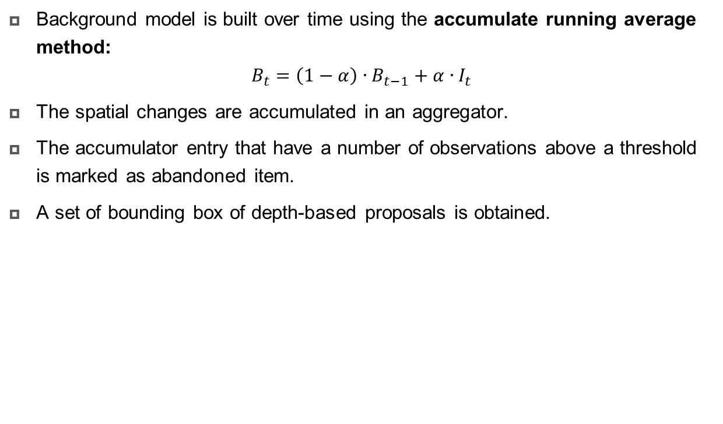


Depth processing
Approach
Background model is built over time using the accumulate running average method:
$$B_{t}=\left(1−α\right)∙B_{t−1}+α∙I_{t}$$
The spatial changes are accumulated in an aggregator.
The accumulator entry that have a number of observations above a threshold is marked as abandoned item.
A set of bounding box of depth-based proposals is obtained.
Original Frame
$$α=0.1$$
$$α=0.01$$

Slide 9
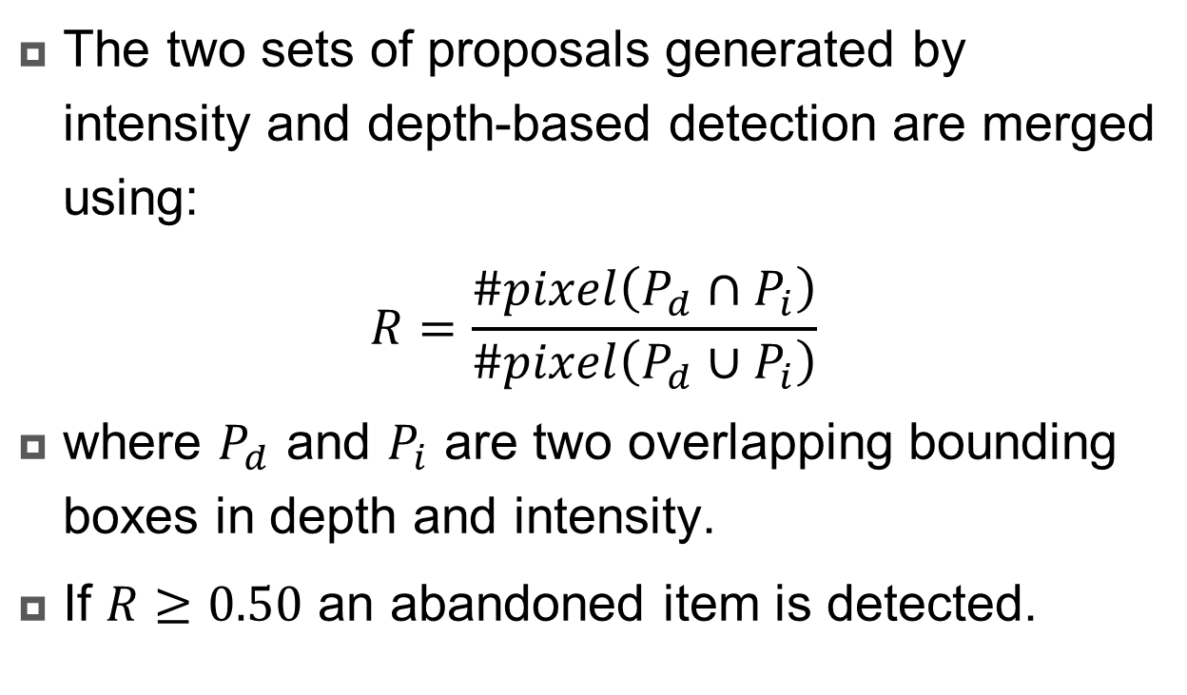
Combination of proposals
Approach
The two sets of proposals generated by intensity and depth-based detection are merged using:
$$R=\frac{\#pixel\left(P_{d}∩P_{i}\right)}{\#pixel\left(P_{d}∪P_{i}\right)}$$
where $P_{d}$ and $P_{i}$ are two overlapping bounding boxes in depth and intensity.
If $R≥0.50$ an abandoned item is detected.

Slide 10
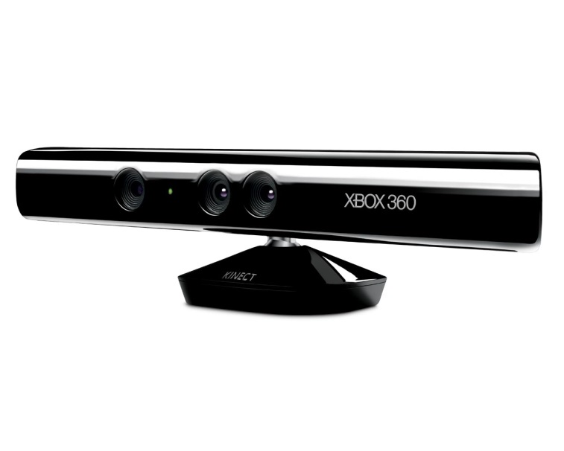





Technologies
Technologies
Video capture with Kinect device
RGB camera:
resolution $640×480$
$8$ bit quantization
Depth sensor:
resolution $640×480$
$11$ bit quantization
USB 2.0 interface
OpenKinect
Open source library
Multiplatform
OpenCV

Slide 11
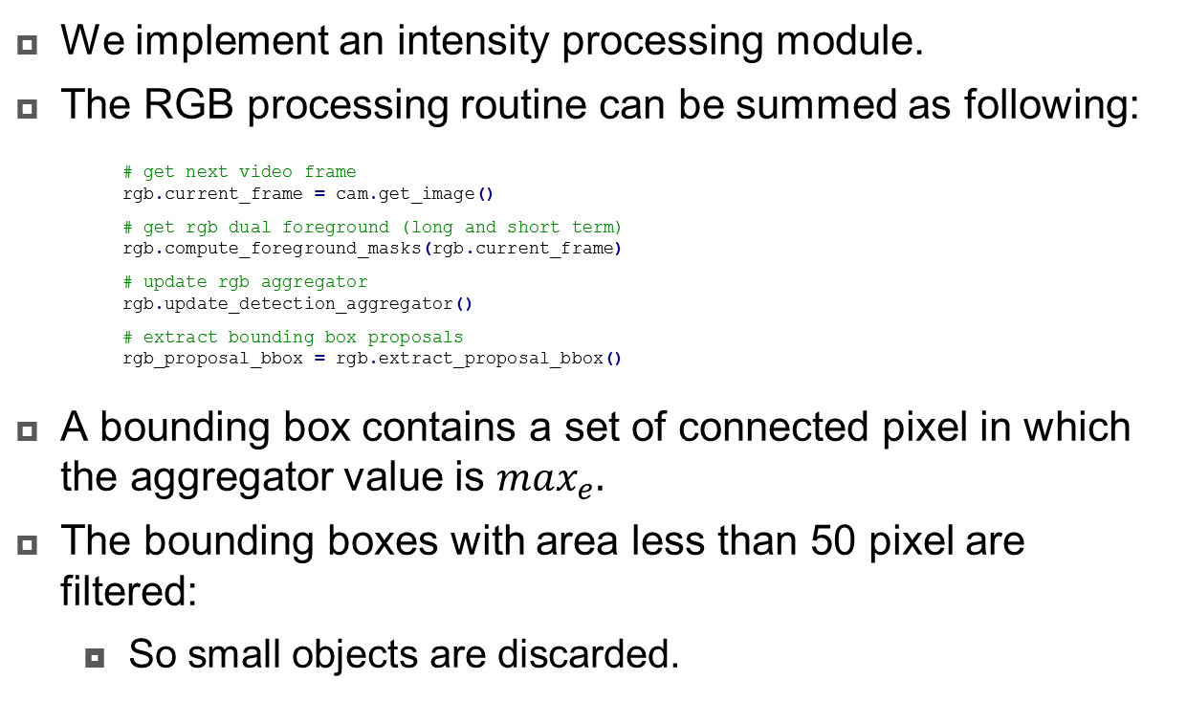
Intensity processing
Development
We implement an intensity processing module.
The RGB processing routine can be summed as following:
# get next video frame
rgb.current_frame = cam.get_image()
# get rgb dual foreground (long and short term)
rgb.compute_foreground_masks(rgb.current_frame)
# update rgb aggregator
rgb.update_detection_aggregator()
# extract bounding box proposals
rgb_proposal_bbox = rgb.extract_proposal_bbox()
A bounding box contains a set of connected pixel in which the aggregator value is $\max_{e}.$
The bounding boxes with area less than 50 pixel are filtered:
So small objects are discarded.

Slide 12
Depth processing
Development
The depth processing routine can be summed as following:
# get next depth frame (11-bit precision)
depth.current_frame = cam.get_depth_matrix()
depth.current_frame_holes = bg_models.compute_holes_mask_in_frame(depth.current_frame)
# get depth background
depth.update_background_model(depth.current_frame, depth.current_frame_holes)
# get depth foreground
depth.extract_foreground_mask_from_run_avg(depth.current_frame)
# apply opening to remove noise
depth.foreground_mask = bg_models.apply_opening(depth.foreground_mask, BG_OPEN_KSIZE, cv2.MORPH_ELLIPSE)
depth_proposal_bbox = depth.extract_proposal_bbox(depth.ACCUMULATOR)
# cut foreground with real values
foreground_depth_proposal = bg_models.cut_foreground(depth.current_frame, depth.foreground_mask)
Is it that simple? Would be nice!!!

Slide 13
Depth challenge
Development
The depth video stream is noisy:
We apply the opening morphological operator.
The depth video stream is not defined everywhere:
it’s available for the image regions that are close enough to the device;
for black objects the sensor can’t measure the depth value;
A proper management of N/D pixel has been implemented.

Slide 14
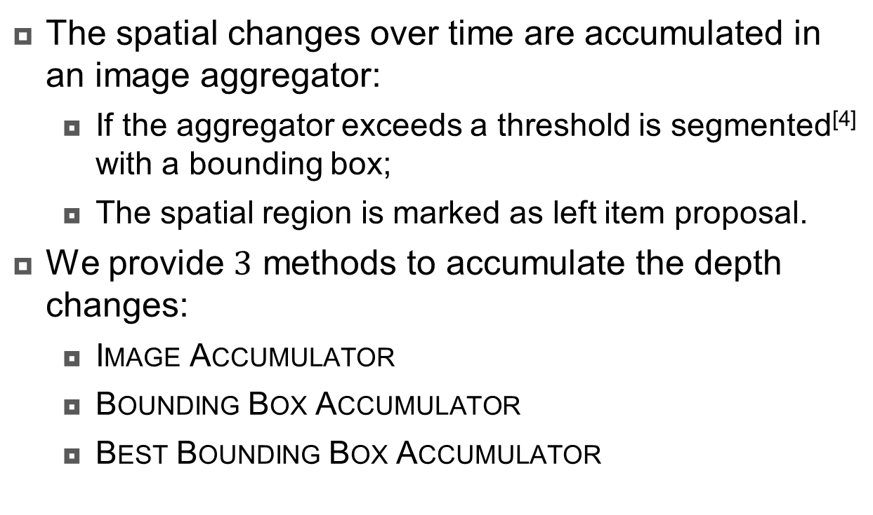
Depth-based proposals
Development
The spatial changes over time are accumulated in an image aggregator:
If the aggregator exceeds a threshold is segmented^{[4]} with a bounding box;
The spatial region is marked as left item proposal.
We provide $3$ methods to accumulate the depth changes:
Image Accumulator
Bounding Box Accumulator
Best Bounding Box Accumulator

Slide 15
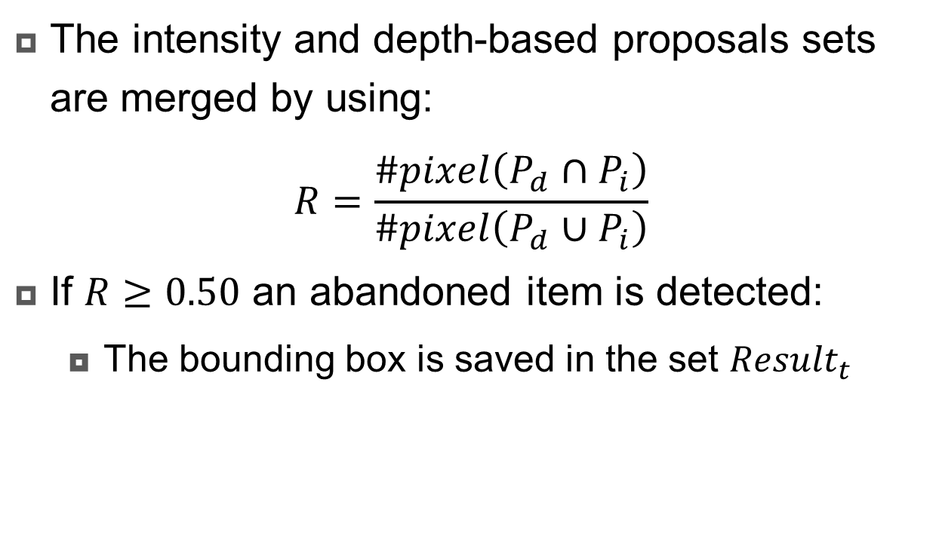
Combination of proposals
Development
The intensity and depth-based proposals sets are merged by using:
$$R=\frac{\#pixel\left(P_{d}∩P_{i}\right)}{\#pixel\left(P_{d}∪P_{i}\right)}$$
If $R≥0.50$ an abandoned item is detected:
The bounding box is saved in the set ${Result}_{t}$

Slide 16
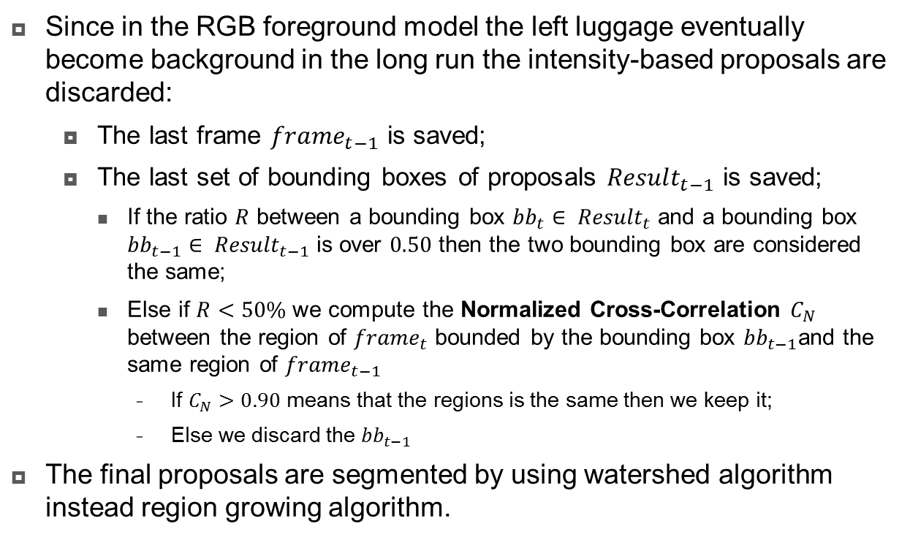
Combination of proposals - improvements
Development
Since in the RGB foreground model the left luggage eventually become background in the long run the intensity-based proposals are discarded:
The last frame ${frame}_{t−1}$ is saved;
The last set of bounding boxes of proposals ${Result}_{t−1}$ is saved;
If the ratio $R$ between a bounding box ${bb}_{t}∈ {Result}_{t}$ and a bounding box ${bb}_{t−1}∈ {Result}_{t−1}$ is over $0.50$ then the two bounding box are considered the same;
Else if $R<50\%$ we compute the Normalized Cross-Correlation $C_{N}$ between the region of ${frame}_{t}$ bounded by the bounding box ${bb}_{t−1}$and the same region of ${frame}_{t−1}$
If $C_{N}>0.90$ means that the regions is the same then we keep it;
Else we discard the ${bb}_{t−1}$
The final proposals are segmented by using watershed algorithm instead region growing algorithm.

Slide 17
Test
Test
We have tested the application using more than 20 videos;
The videos of interest are available for download through this link;
Video04: no clutter, no occlusions, one person, one left luggage; ✔✔✔
Video05: no clutter, two luggages, occlusions, standing people; ✔✔✔
Video12: no clutter, three luggages, illumination; ✔✔✘
Video13: clutter, two luggages, occlusions, illumination; ✔✔✘
Video16: clutter, two luggages, occlusions, illumination; ✔✔✘

Slide 18
Performance
Test
The approach used in this application is demanding in term of performance. The proposed framework runs at 5 fps on a modern notebook, just like the one proposed in the paper from which the authors were inspired.

Slide 19
References
References
[1] C. Beleznai, P. Gemeiner and C. Zinner, Reliable Left Luggage Detection Using Stereo Depth and Intensity Cues
[2] Z. Zivkovic and F. Heijden, Efficient adaptive density estimation per image pixel for the task of background subtraction
[3] F. Porikli, Y. Ivanov and T. Haga, Robust abandoned object detection using dual foregrounds
[4] Suzuki, S. and Abe, K., Topological Structural Analysis of Digitized Binary Images by Border Following. CVGIP 30 1, pp 32-46 (1985).

Slide 20


Thanks
Q & A
Left luggage detection
June 13th, 2014
Course of Multimedia Databases – a.a. 2013-14
Andrea Rizzo, Matteo Bruni

